Slide 1
Somalogic Selection Panel

Slide 2

Wu Tsai Alliance
Bone Stress Injury Working Group
Jan 24, 2022

Slide 3
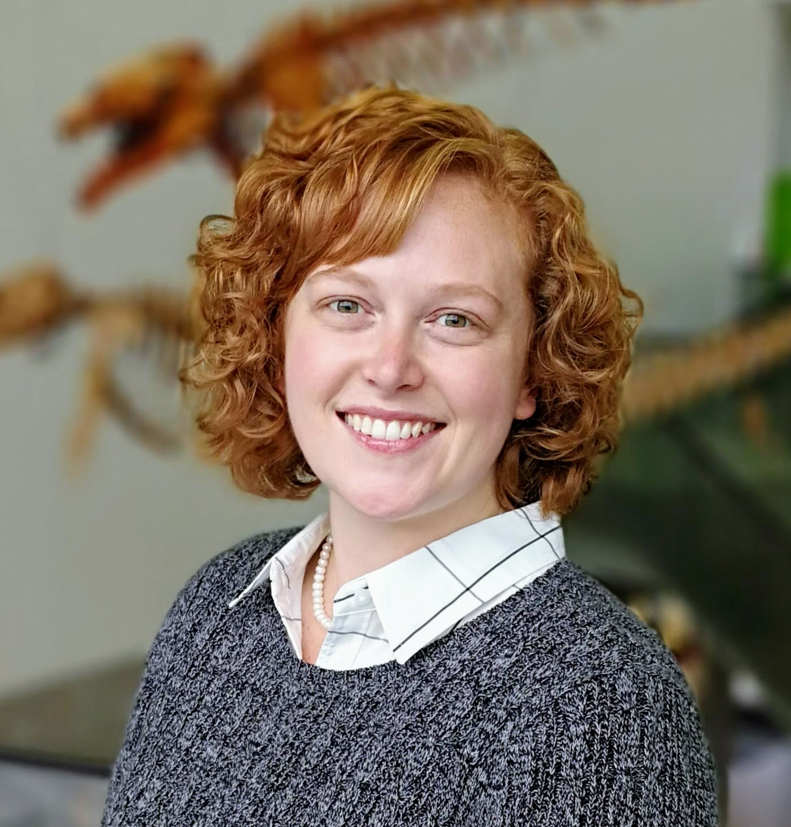
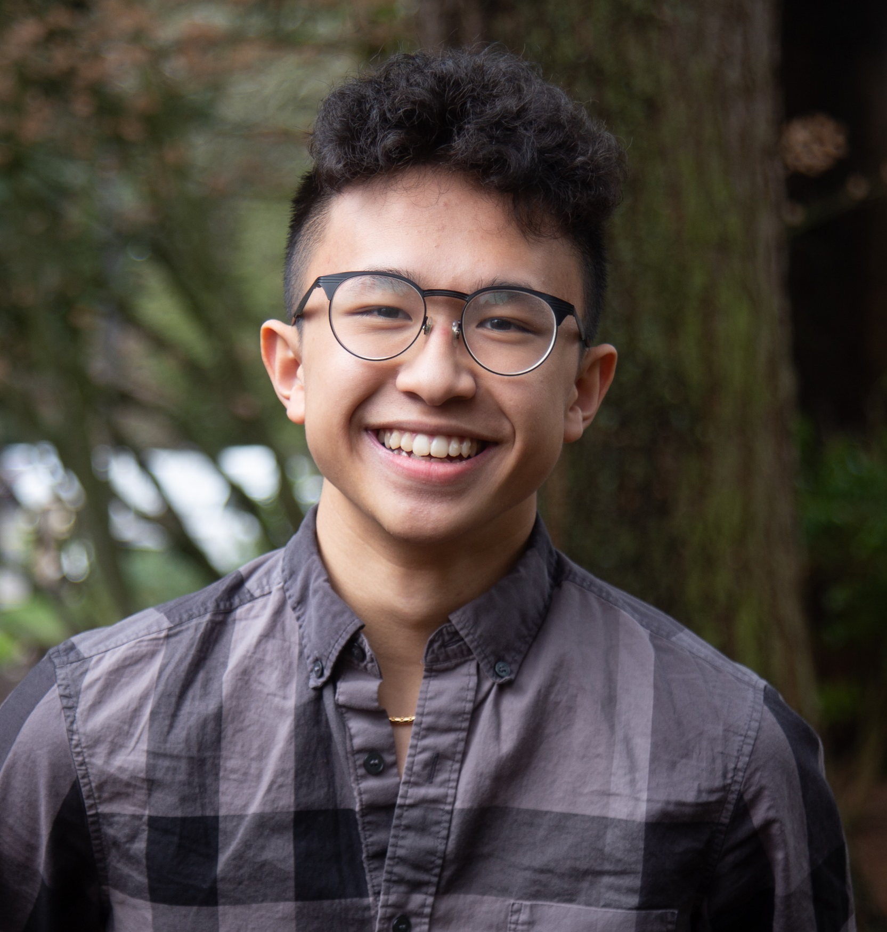
Genny Romanowicz
Position: Post-doctoral scholar
Affiliation: University of Oregon
Key Needs (from a clinician or researcher perspective):
Our goal is to identify predictive (serum) markers of bone mechanics and/or healing.
Prior Work (including any datasets, if relevant):
Non-linear regression models and machine learning algorithms
including bone morphology and tissue quality → mechanics
3D image evaluation
Mass spectrometry of serum markers and direct measures of bone collagen cross-links.
Planned or Ongoing Projects:
New collaboration with Mary Bouxsein, Kristin Popp, & Kathryn Ackerman to analyze serum protein markers for indication of immune, metabolic or hormonal dysregulation in athletes with tibial bone stress injuries.
Input/Help Needed:
Any additional serum detectable proteins that may be of interest to this group that we can include in our 1500 protein panel.
Ethan Dinh
Position: Knight Campus Undergraduate Scholar

Slide 4

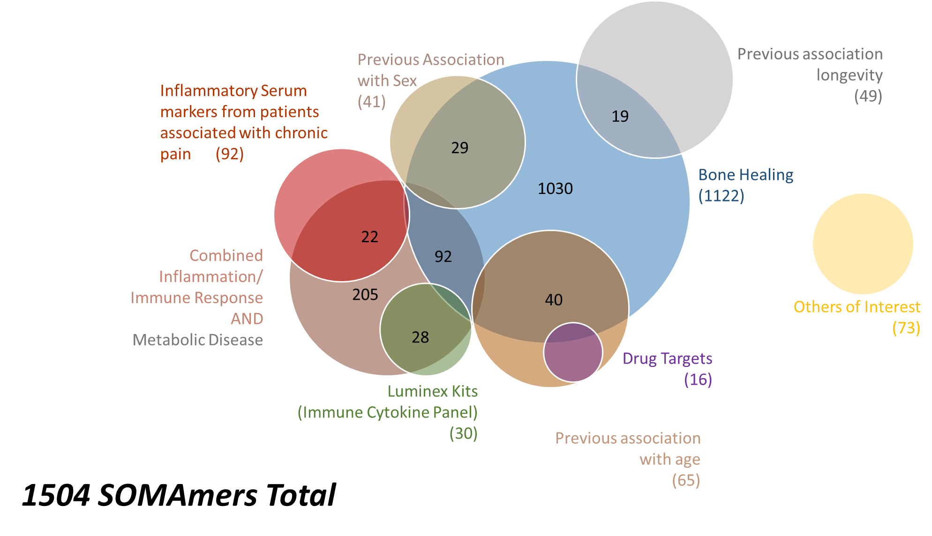
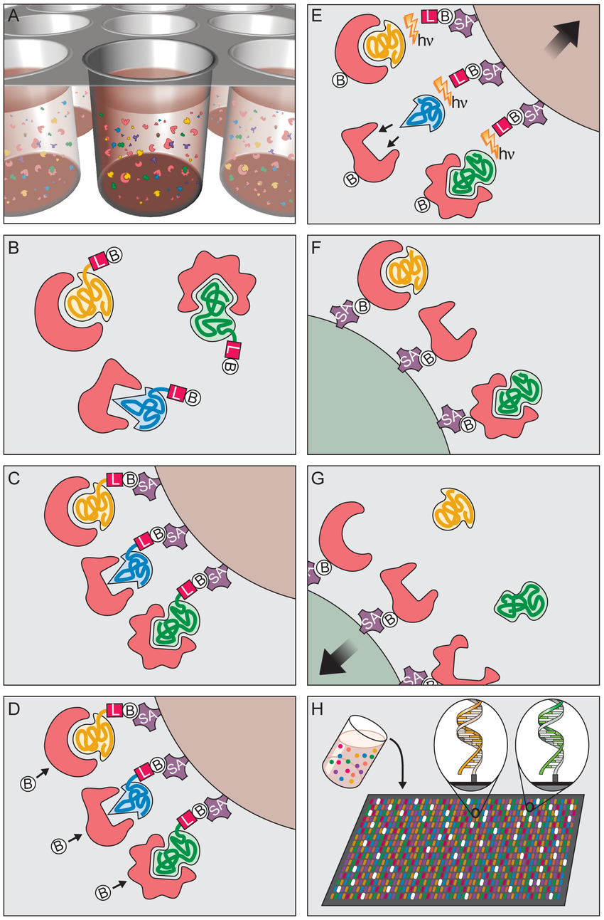
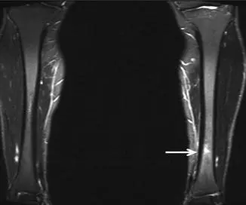
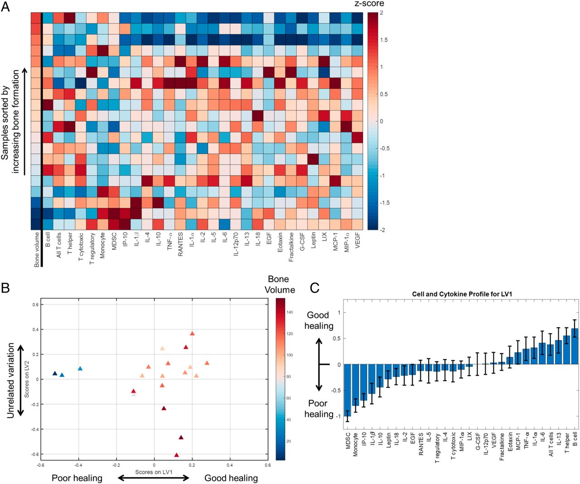
Genny Romanowicz
Position: Post-doctoral scholar
Affiliation: University of Oregon
Goals:
Ethan Dinh
Position: Knight Campus Undergraduate Scholar
Derive from proteomic study:
Prediction of bone healing
Return-to-play guidelines
Aging processes in young athletes
Somalogic Aptamer
Based Protein Analysis
(1500-7000 analytes)
Guldberg Lab Predicting bone healing from immune profile and cytokine markers
30 Female Athletes Cohort with Tibial Bone Stress Injury (BSI)
(10 with BSI reinjury)
Popp, et al., AJSM 2020
Cheng, et al., PNAS 2021
Notes:
https://www.facebook.com/photo/?fbid=352123836698885&set=pb.100057038156800.-2207520000..
https://www.researchgate.net/publication/49689994_Aptamer-Based_Multiplexed_Proteomic_Technology_for_Biomarker_Discovery/figures?lo=1&utm_source=google&utm_medium=organic
https://musculoskeletalkey.com/stress-fractures-of-the-tibia/

Slide 5
Inflammation & Immune Response
(938)
Combine two most likely pathway selections from SomaLogic
Metabolic Disease
Inflammation and Immune Response
Screen selection for any obvious exclusion/inclusions based on bone fracture related hypothesis
Search for any additional inclusions based on previous literature
Original SOMA paper had lists of potential druggable targets, some with current drugs available (low hanging fruit if one of these hits)
19 of these
Age and Sex correlated SOMAmers from original SOMA paper (~80 proteins)
Compare with Luminex
756
481
160
92
114
Bone Healing
(1122)
205
Metabolic Disease
(902)
491

Slide 6
Bone Healing
(1122)
1030
Combined Inflammation/ Immune Response
AND
Metabolic Disease
92
205

Slide 7
Inflammation/ Immune Response
AND
Metabolic Disease
OR
Bone Healing
1327

Slide 8
Previous Association with Sex
(41)
32
5
4
Combined Inflammation/ Immune Response
AND
Metabolic Disease
AND
Bone Healing
Previous association with age
(65)
1327
6
55

Slide 9
Combined Set
1327

Slide 10
Bone Related or of Interest
111
Combined Inflammation/ Immune Response
AND
Metabolic Disease
AND
Bone Healing
Inflammatory Serum markers from patients associated with chronic pain
1327
92
49
Previous association longevity
Drug Targets
30
16
Luminex Kits
(Immune Cytokine Panel)

Slide 11
Total SomaLogic Custom Count
1504

Slide 12
Things to discuss as a group
Option 1: 1500 panel for all samples
IF – then does everyone agree with my selection criteria?
Option 2: 7000 for a subset and 1500 (informed by 7000) for the remainder
IF – then which time point does Kristin Popp think is most interesting?
Details:
Functional continuous variable as outcome variable for regressions (FEA stiffness)
Internal normalization (biologic and synthetic)
Modeling approaches → can we get Mary’s data set to play with? (ie. Ethan)
DataAnalyzer
Machine Learning or AI
Notes:
Read more on proteomics in athletes
Look at Luminex v. soma
Internal standard
Correlation within existing data (Ethan?)

Slide 13
Popp Study
Materials
30 participants * 5 time points = 150 samples
1-1.5 mL aliquots of serum per visit (up to 7 mL) per person
SomaLogic needs 130 uL of serum (55 uL will be used, remainder returned)
Previous Study
All female athletes with diagnosed tibial stress fracture
Time points: BL (within 3 weeks of diagnosis); 6, 12, 24 and 52 weeks post injury.
10 experienced a second injury (1 incurred 2 injuries)
Major findings:
BL → 12 w post frac, ↓ total, trab, & cortical vBMD (injured) w/ ↓ total & trab (uninjured)
Restoration at 24 weeks
52 weeks, some exceeded baseline
Subsequent fracture group was younger, later age at menarche, hx of prev fx, ↓ serum PTH

Slide 14
Popp Study
Blood Draws
AM fasting
Vitamin D
PtH
Iron
Ferratin
Height + Weight + BMI
Tibial length (external)
DXA (baseline)
Lumbar spine
Femoral neck
Total Hip
HR-pQCT
Cortical vBMD
Trabecular vBMD + Tb sp., th..
Total Area
Cortical Area
Cortical Porosity
FEA → stiffness and failure load (axial compression)
Initial analysis
Linear Mixed Model (essentially repeated measures)
Health History
Fx history
Menstrual status
Contraceptive use
Physical activity hx
Weight bearing
Non-weight bearing
All self reported
Pain (1-10)
Palpation of the tibia, ambulation and running

Slide 15
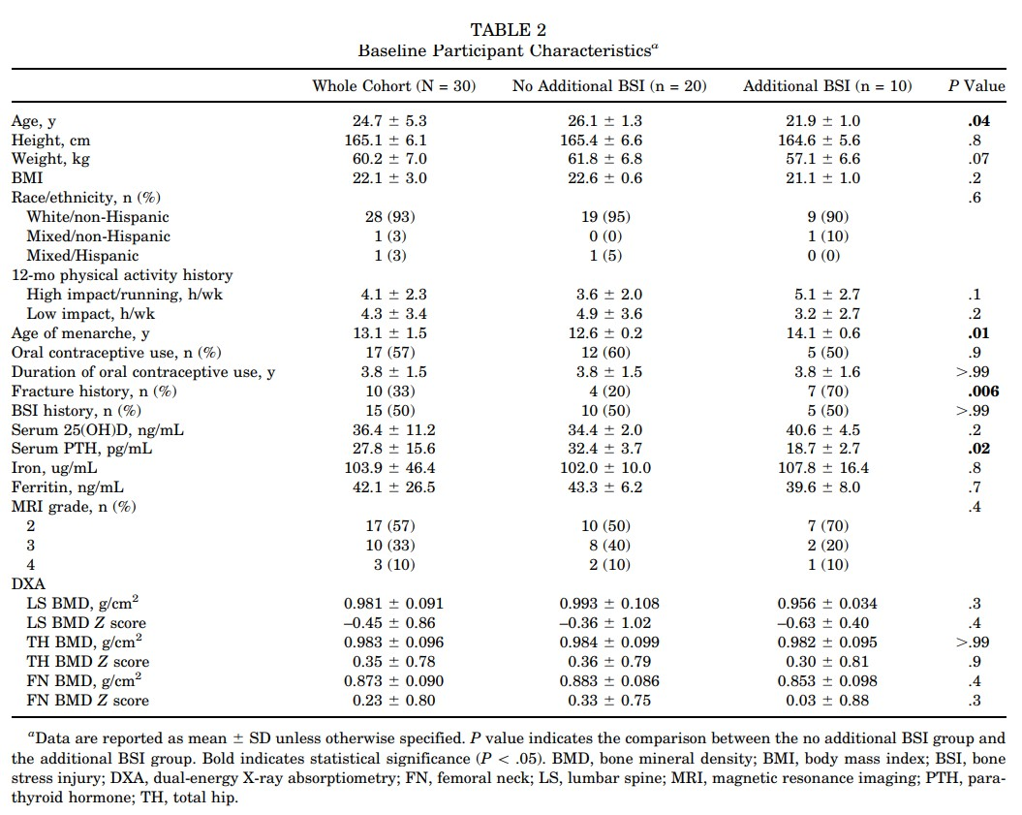
P-values are a comparison of no additional and additional BSI groups
Additional BSI had:
Age (~5 years younger)
Later menarche (~ 2 years)
Fx Hx
Lower PTH (~ ½), and slightly elevated (n.s.) Vitamin D.
Counterintuitive to BMD decrease (ns)?
I did not see tibial length listed as an outcome in any tables

Slide 16
Possible hypothesis angles
PTH + Vitamin D – altered metabolism and endocrine system
Mineral and matrix – since BMD was decreased with injury, but a subset went on to fracture again with no significant change in BMD, could point to non-mineral component of bone (collagen, NCP or hydration)
Pain and/or inflammation axis? Endogenous opioid receptors as well as inflammatory cytokines
Immune dysregulation
Responder/non-responder (non-linear regression analysis)
Look at age and exercise only as a backup?

Slide 17
Considerations
Type of analysis/databases
Data storage
Internal standard?
Statistical power

